Slide 2

Code of Conduct
Remember the Golden Rule: Treat others as you would want to be treated - with kindness and respect
Scan the QR code to access and
review the CNCF Code of Conduct:

Slide 3

Virtual Audience Closed Captioning
Closed captioning for the virtual audience is available during each session through Wordly. The Wordly icon will appear at the bottom of the platform screen once you are logged into each session.
To activate Wordly, simply click the icon and choose from one of 26+ languages available so you don’t miss a beat from the presenters.
*Note: Closed captioning is ONLY available during the scheduled live sessions and will not be available for the recordings on-demand within the virtual conference platform.

Slide 4
Session Q+A
Virtual attendees may submit questions to speakers through the CNCF Slack channel: #2-Kubecon-sessions
Please create a thread and tag the speaker(s) with questions about their talk.
Questions will be answered by the speaker and/or other community members after the session concludes.

Slide 5

Sponsor Shout-Out!
Thank you to our Session Recording Sponsor:

Slide 6
Enjoy the Session!

Slide 7
Tales from on-call: Fun with Operating Etcd at Scale
Geeta Gharpure & Chao Chen,
EKS @ Amazon Web Services

Slide 8
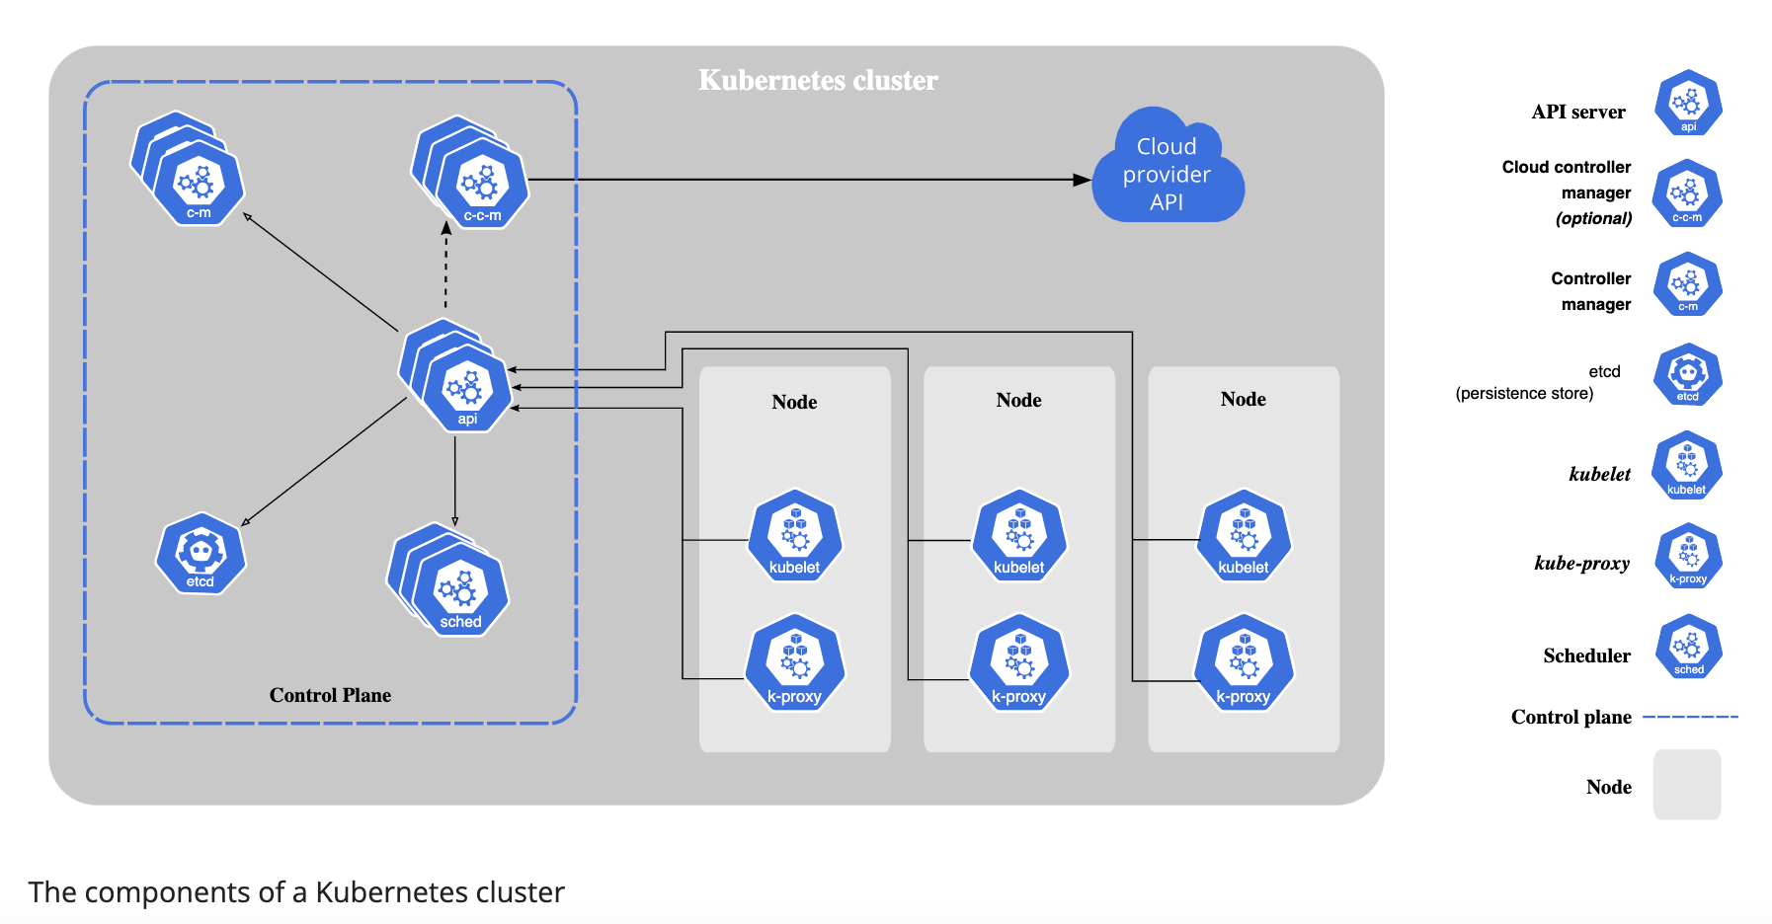

Introductions
EKS manages the control plane – all aspects of it – availability, scalability, performance
Customer - Customers do not have access to the control plane. They manage the workloads on the cluster.
We are part of the team that operates etcd for EKS.
reference - https://kubernetes.io/docs/concepts/overview/components/

Slide 9


Slide 10
etcd @ EKS
1. Each etcd cluster is a 3 node cluster
2. kube-apiserver uses auto-sync to update etcd server endpoints with its latest membership
3. EKS etcd supports version downgrade from 3.5 to 3.4
4. etcd runs as a systemd daemon service
5. etcd operator runs in the same box as etcd

Slide 11
Agenda
Lets talk about some operational issues
Etcd database size quota breach
Revision divergence
Out of memory
Timeouts
Request size too large

Slide 12

1.Etcd database size quota exceeded

Slide 13
Etcd database size quota exceeded
What is this issue? Some concepts -
Quota
MVCC
Compaction
Defrag
Alarm and Disarm
References
1. Quota - https://etcd.io/docs/v3.3/dev-guide/limit/#storage-size-limit
2. Compaction - https://github.com/etcd-io/etcd/issues/14595

Slide 14
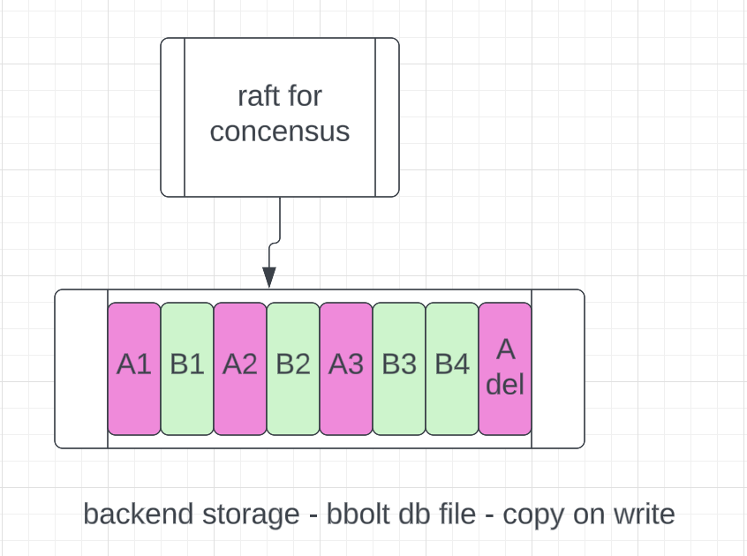

Etcd database fills up
raft
Quota is about size of backend db file
Multiple revisions per key – copy on write
Deletion ‘adds’ to db file – writes a tombstone
Alarm activates at quota; needs explicit disarm
Today, EKS operates with 8GB quota
Cluster becomes read-only

Slide 15
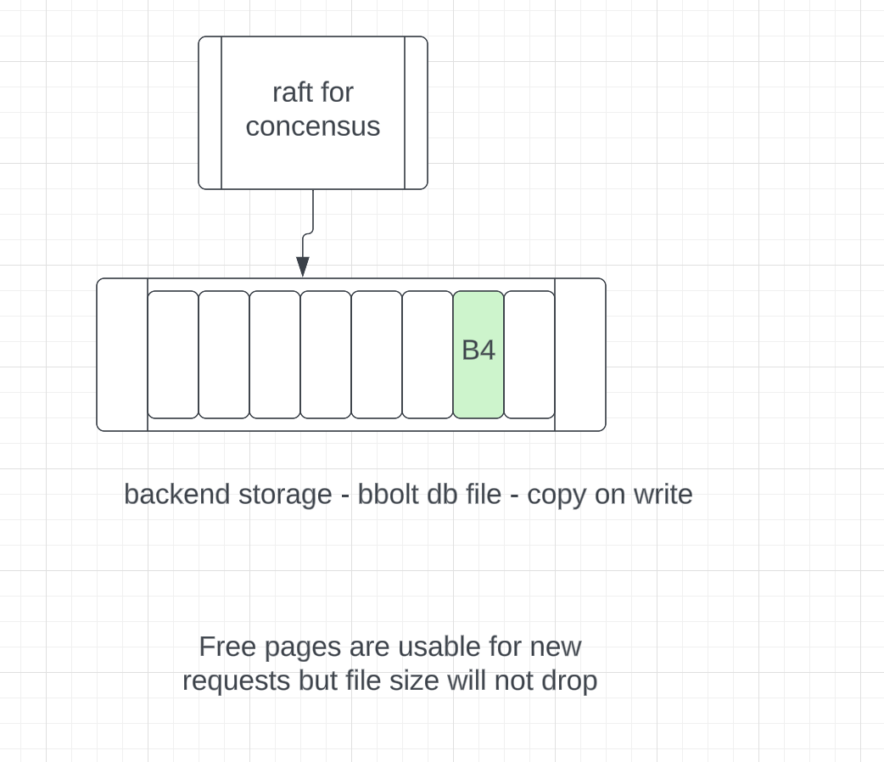
Etcd compaction
raft
Quota applies to the size of the db file and not to ‘in-use’ bytes
In EKS environment, compaction is run every 5 minutes by the apiserver
When there is no alarm, the ’holes’ can be used by etcd.
But when in alarm, request is denied even if there is space available inside the db file.

Slide 16
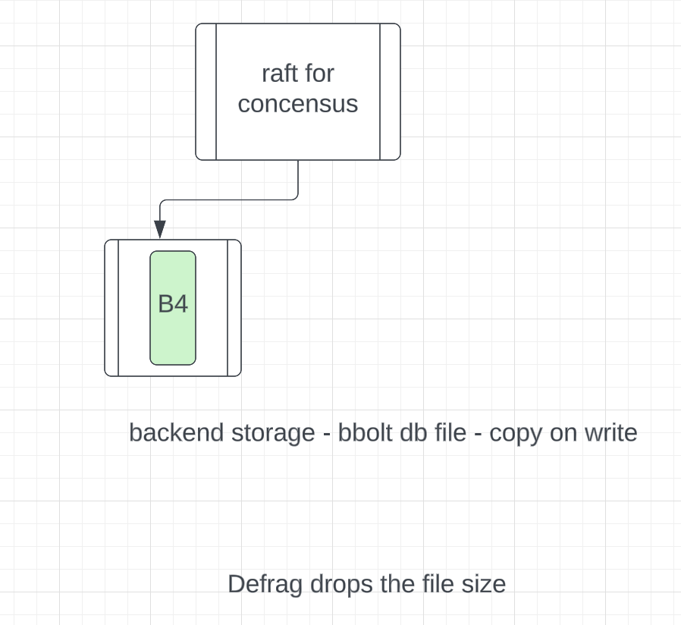
Etcd defrag
raft
Defrag is run by the operator – in EKS environment we have an operator agent to do this.
Although file size drops, alarm does not clear. Explicit disarm is needed to turn off the alarm.

Slide 17
Etcd database size quota exceeded
What is this issue?
Workloads exceed the etcd backend quota – mostly unintentionally
When this limit is reached, etcd cluster becomes read-only
Compaction run by api-server stops
Operator intervention is required to disarm the cluster
Deletion of the objects may need more space…
References
1. Quota - https://etcd.io/docs/v3.3/dev-guide/limit/#storage-size-limit
2. Compaction - https://github.com/etcd-io/etcd/issues/14595

Slide 18
Etcd database size quota breach
Why do we see this issue?
Object count – too many keys
Object size – blob pod spec
Revisions – repeated updates
Object Size
Object Count
Revisions
Blog post - https://aws.amazon.com/blogs/containers/managing-etcd-database-size-on-amazon-eks-clusters/
Notes:
Give examples of each

Slide 19
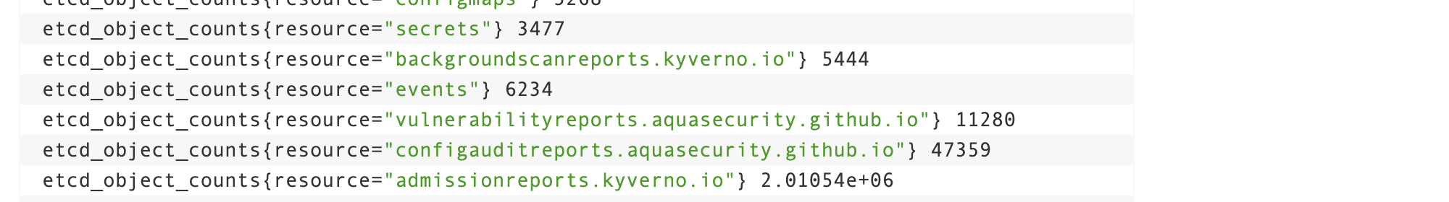
Object count
Millions of objects, typically a few KB each.
Blog post - https://aws.amazon.com/blogs/containers/managing-etcd-database-size-on-amazon-eks-clusters/
Notes:
Give examples of each

Slide 20
Object size
Big blob – about 500k – in a pod spec
This can be optimized by using reference to that blob via configmap or secret.
Blog post - https://aws.amazon.com/blogs/containers/managing-etcd-database-size-on-amazon-eks-clusters/
Notes:
Give examples of each

Slide 21
Repeated updates
Why are 1000 pods taking up 8GB space !
MVCC - Older reversions stick around until compaction runs
Consider 800k pod spec. 10 rev each. Each pod is taking up 8MB !
Typically rev updates is exacerbated by relatively bigger object size.
Audit logs can help identify the fast updates. Example of an update -
requestObject.status.conditions.0.message: 0/334 nodes are available:
230 node(s) didn't match Pod's node affinity/selector,
3 node(s) had taint {node.kubernetes.io/not-ready: }, that the pod didn't tolerate,
65 Insufficient ephemeral-storage,
81 Insufficient memory.
Blog post - https://aws.amazon.com/blogs/containers/managing-etcd-database-size-on-amazon-eks-clusters/

Slide 22
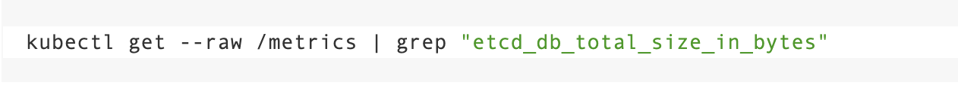
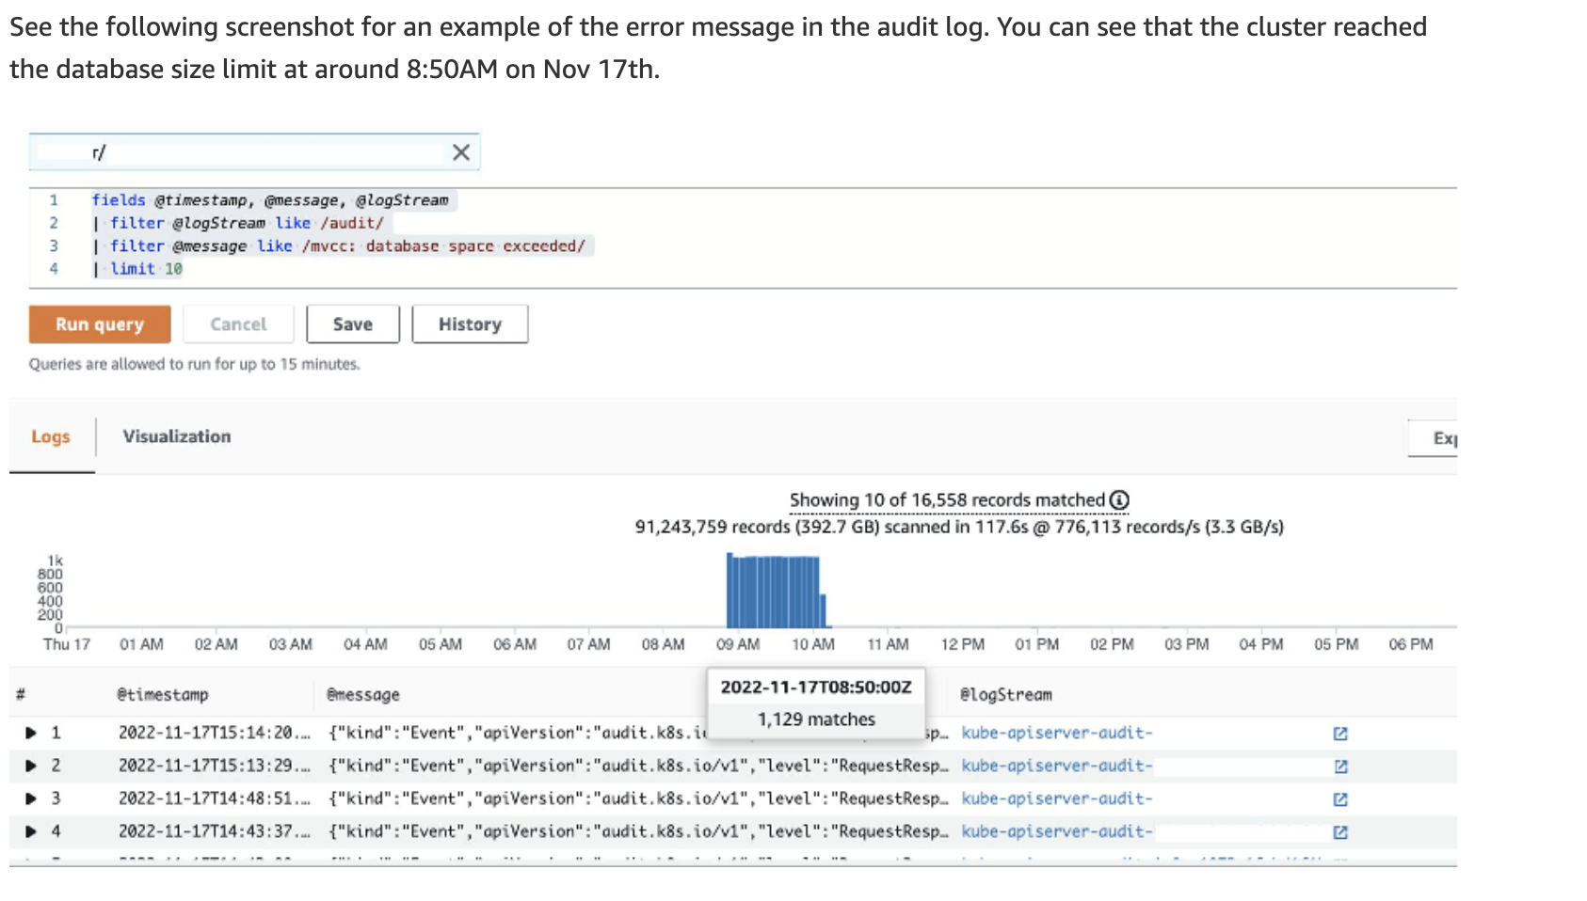
Monitoring for db quota

Slide 23
Etcd database size quota breach - Mitigation
Alarm
Automatic recovery [WIP]
Self service deletion [WIP]
Increase the quota?

Slide 24

2.Etcd Revision Divergence

Slide 26
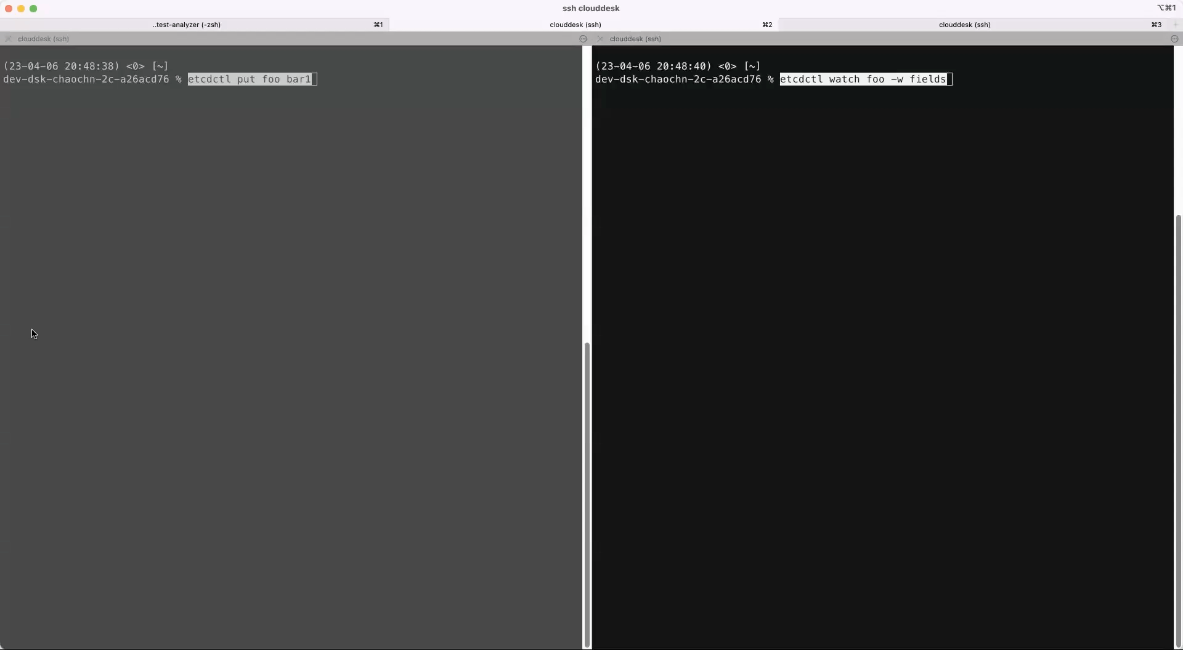
What is revision in etcd ?

Slide 27
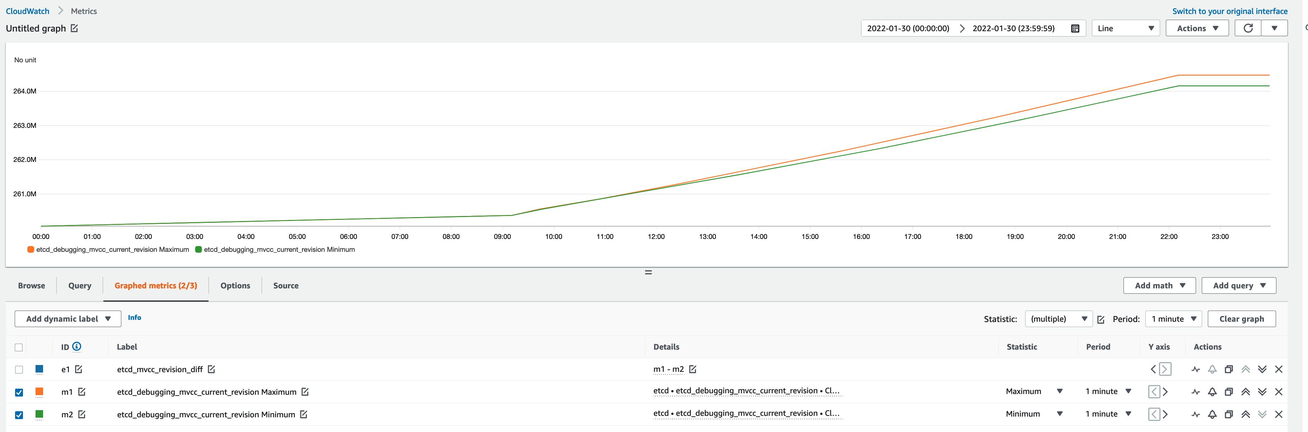
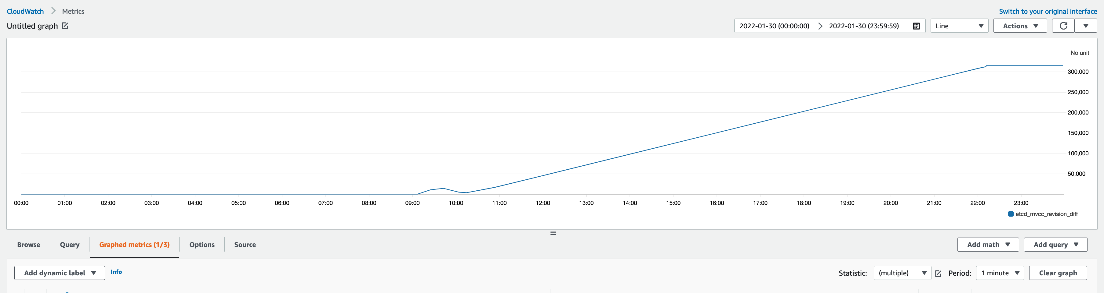
Real world example
etcd_debugging_mvcc_current_revision (max – min) grows indefinitely
Alternative Prometheus / Grafana alert configuration

Slide 28
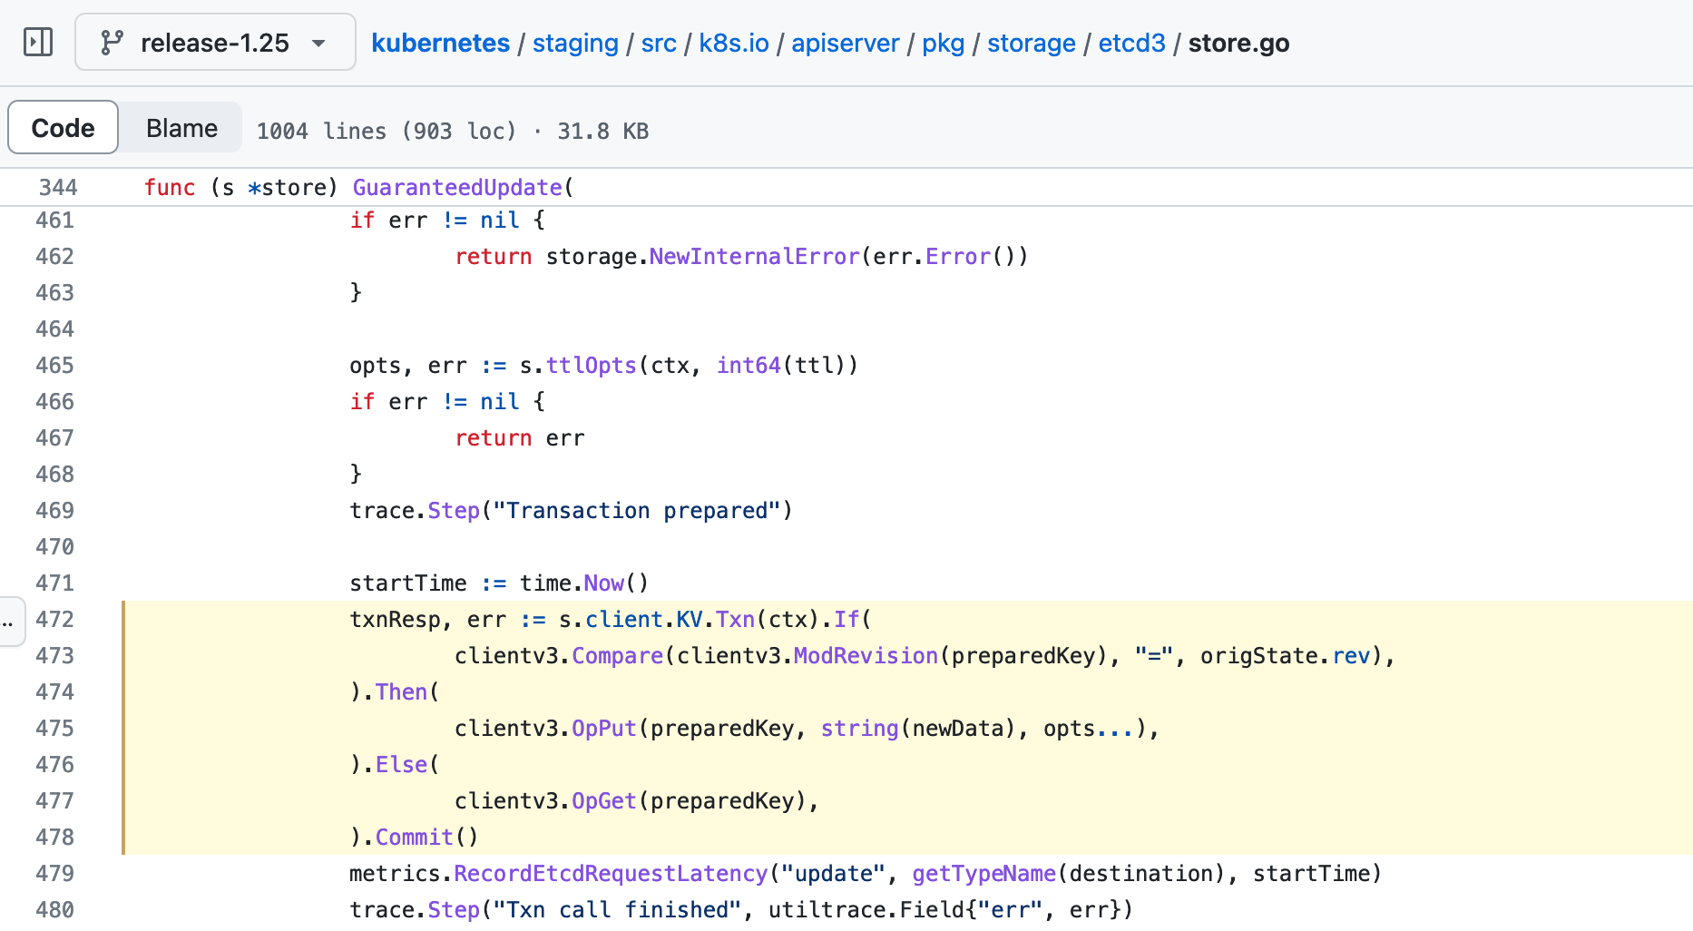
How the revision divergence grows?

Slide 29
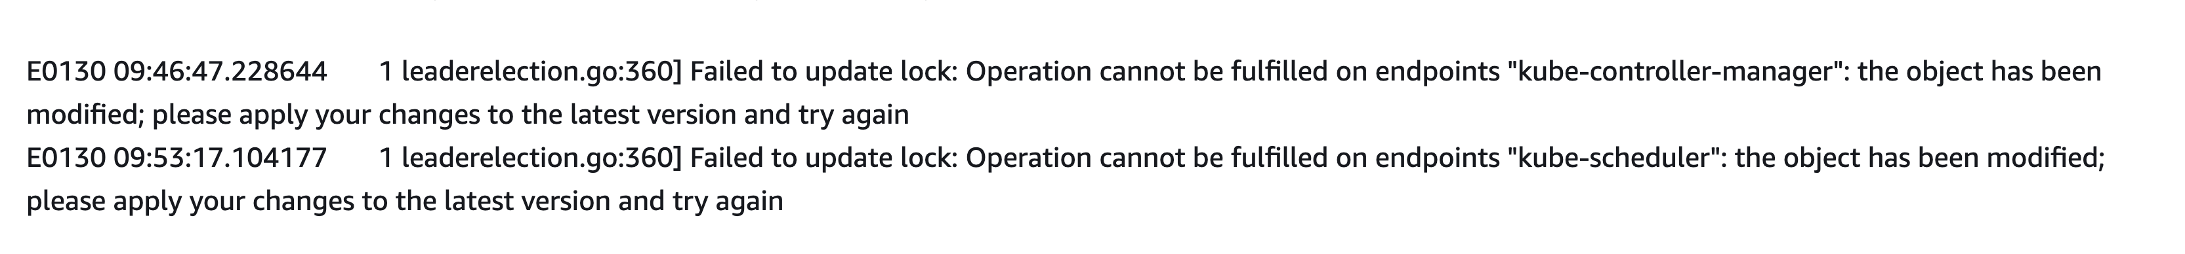
Impact
Core k8s components fail to acquire the lease and stop functioning
[indent more ] kube-scheduler
[indent more ] kube-controller-manager
Many more
Deployment scaling and pod scheduling will fail

Slide 30
Mitigation
1. Remove the revision lagging behind member
2. Join a fresh new member to be in sync with other members
https://etcd.io/docs/v3.5/op-guide/data_corruption/

Slide 31
Root cause
etcd MVCC partial commits and etcd process panics
bbolt (etcd backend) corruption.
etcd github data inconsistency summary

Slide 32

3.Etcd running out of memory
PANIC

Slide 33
Etcd out of memory
What is this issue?
Under heavy load etcd can run into out of memory
Typically the condition cascades and can cause quorum loss
Workload causing the overload – typically large range requests

Slide 34
Etcd out of memory
Why do we see this issue?
Unpaginated requests
Workload spikes too much too fast.
Every req is new allocation – GC is asynchronous

Slide 35
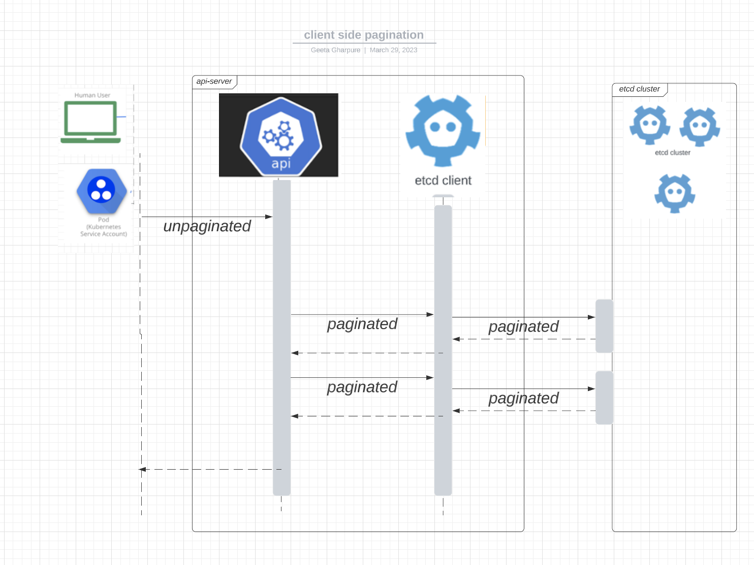
Mitigation - Client side pagination
Kube-apiserver internally paginates the unpaginated requests KEP -https://github.com/kubernetes/enhancements/pull/3252

Slide 36
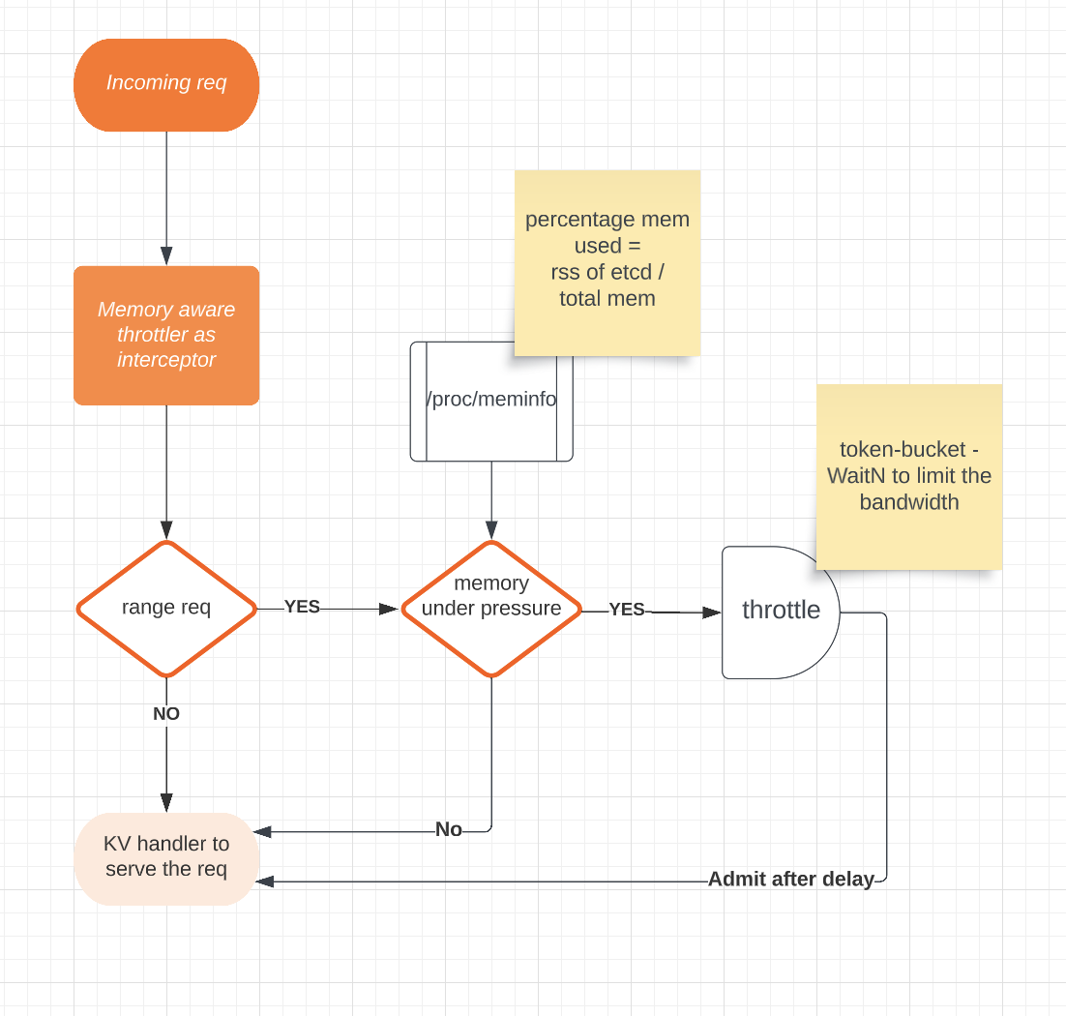
Mitigation – Server side throttling
Pull Req – https://github.com/etcd-io/etcd/pull/14035

Slide 37
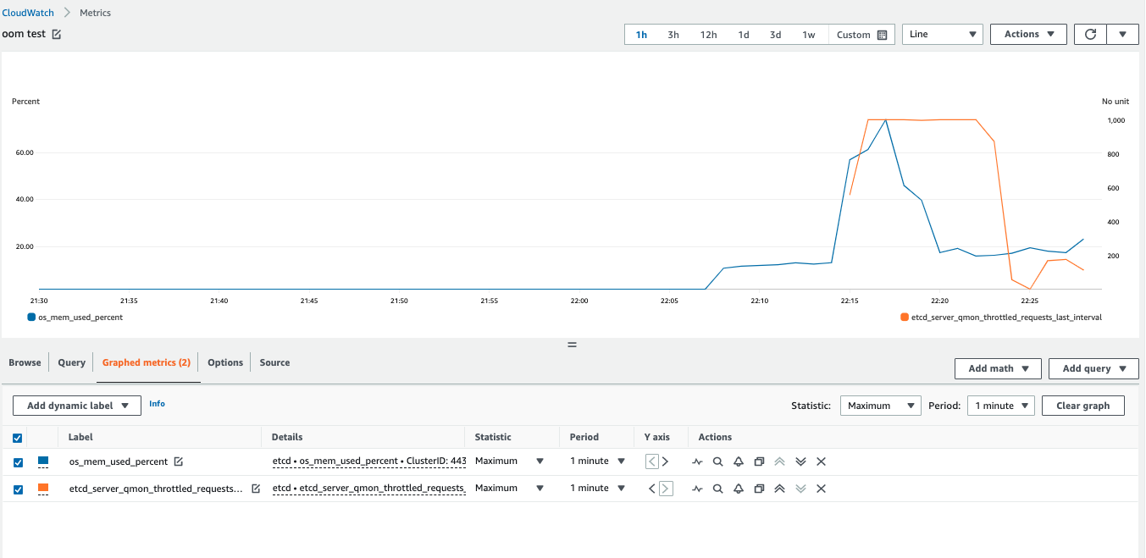
Server side throttling

Slide 38
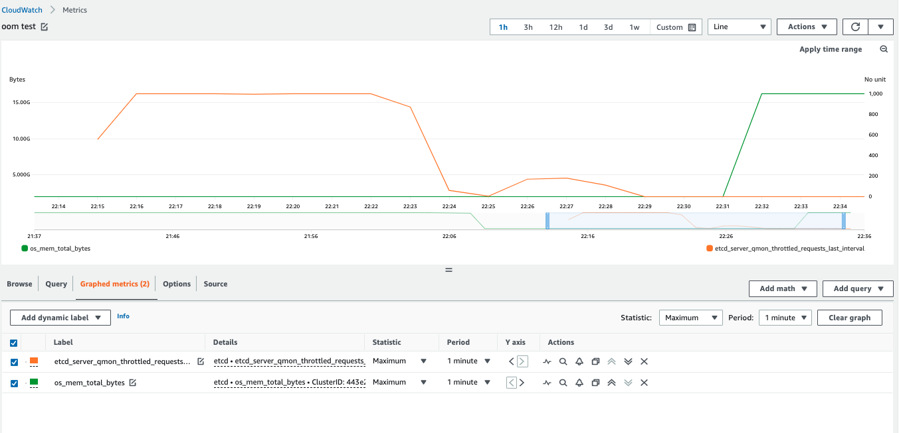
Server side throttling – component of scaling system

Slide 39
Server side throttling
Can I use these changes?
You may not need it if you have control on the workload and cp.
In that case, cluster can be scaled up manually before
starting a very spiky workload or provision for peak load at all times.
If you are interested in using this change, please contact us!
(github handles - geetasg, chaochn47)

Slide 40


5xx
4.Timed out

Slide 42
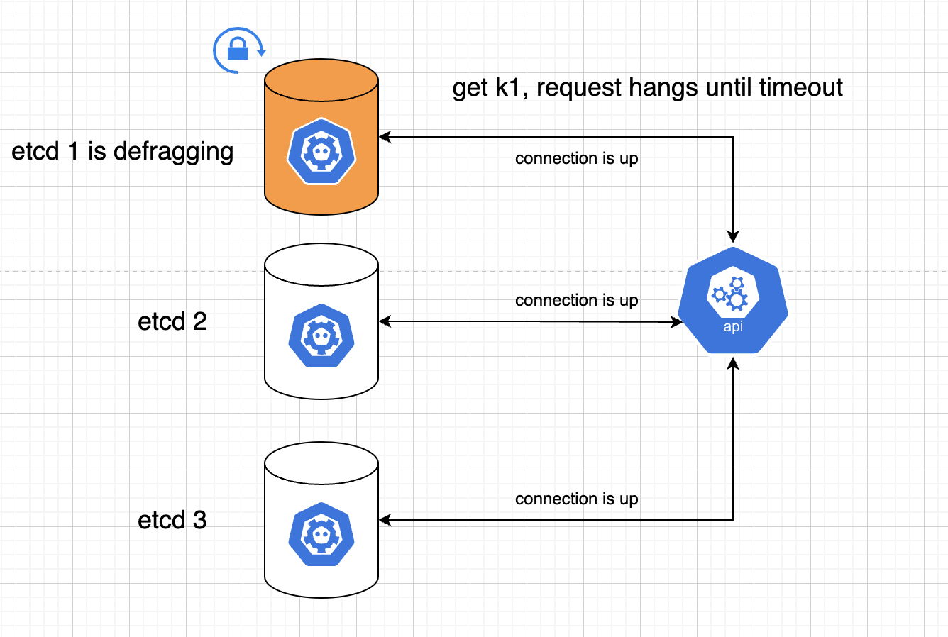
Timed out: etcd defrag
One of the top contributors of Kubernetes API server 5xx is
etcd defrag

Slide 43
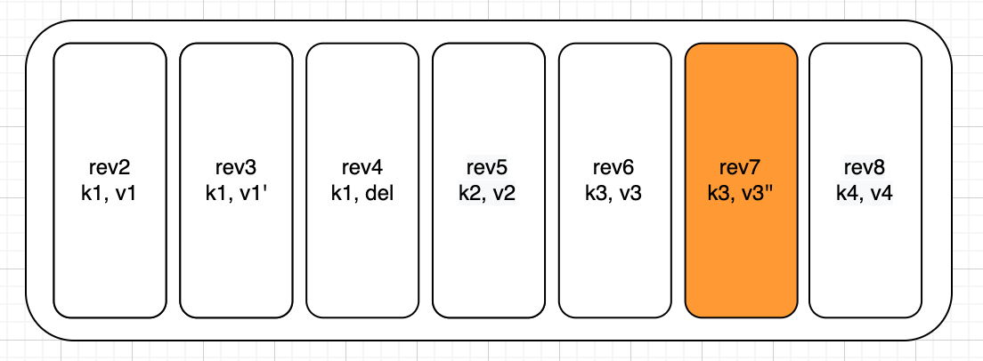
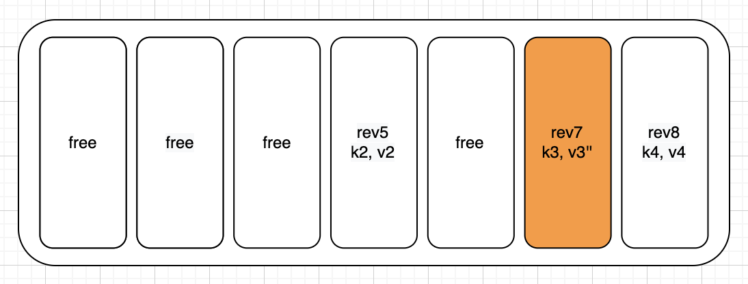
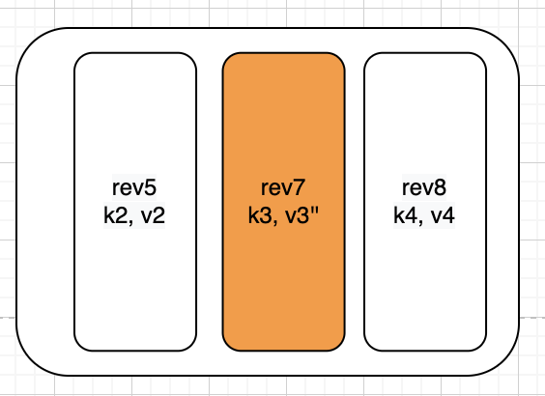
What is etcd defrag?
1. After compaction
2. After defrag, DB file size shrinks

Slide 44
Mitigation
Reduce the frequency of online defrag
Reduce the latency of defrag
keep the number of keys in etcd small
increase the disk throughput
defrag offline

Slide 45
Future works
etcd upstream graceful etcd defrag proposal
etcd client to fail over defragging server endpoint
make defrag concurrent internally and not blocking

Slide 46

5.Request size too large
OVERSIZED LOAD

Slide 47
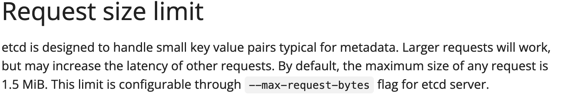
Request size too large
What is this issue?
Workload wants to submit a request that is bigger than request size limit of etcd
https://etcd.io/docs/v3.5/dev-guide/limit/

Slide 48
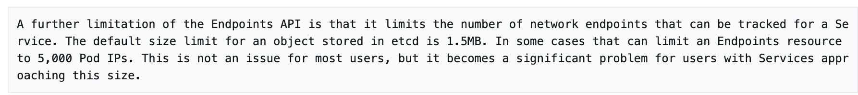
Request size too large
Why do we see this issue?
One case we have seen is where the workload wanted to update Endpoint objects for Kubernetes Service. Workload was redesigned to use Endpoint slices instead. This turned out to be a known upstream issue –
https://kubernetes.io/blog/2020/09/02/scaling-kubernetes-networking-with-endpointslices/

Slide 49
Request size too large
Mitigation
While it is possible to change the request size param for etcd, so far, we have opted to review the workload with our customers and advise on how to restructure it so as to not cross the limit.
We prefer to stay with upstream limit.

Slide 50


Summary – we discussed 5 operational issues
PANIC
5xx

Slide 51
Q & A
Thanks !
How to contribute to etcd upstream ?
https://github.com/etcd-io/etcd/blob/main/CONTRIBUTING.md
Contact us on slack
Chao - chaochn47
Geeta - geetasg

Slide 52

Session QR Codes will be
sent via email before the event
Please scan the QR Code above
to leave feedback on this session

